Slide 1


PDM Plan
Tittle : Early warning system for bankrupt prediction by using machine learning methods
Presented By: Vasanth Kumar Mekala
Git Hub Link:

Slide 2

INTRODUCTION
Bankruptcy is a financial event that can have harsh consequences for stakeholders, including creditors, regulatory institutions, employees, and investors.
In such circumstances, bankruptcy prediction plays a significant role in supporting economic growth and maintaining financial stability.
Aim and Research Question
Aim:
The main aim to develop bankrupt predictive system to identify the companies that are at risk before it happens.
Research Question:
Can Machine learning models accurately predict company bankruptcy based on corporate governance indicators and the financial ratios?
Notes:
Good morning, everyone. This project is on the spaceship Titanic dataset, where the transportation has been predicted by machine learning and AI. The project is similar to the Titanic challenges but set in a futuristic scenario, where the spaceship travels and transportation to another dimension has been presented. All the steps of data analytics and model development have been followed for efficient prediction. The Titanic dataset represents the binary classification challenge of predicting the transportation of passengers in another dimension. The analysis has been performed depending on the features, such as age, cabin details, additional travelling information, and spending on the amenities on the spaceship.

Slide 3
DATASET DESCRIPTION
The Data set obtained from Kaggle, a publicly available free to use.
It consisting of 6819 entries with 96 columns which are financial metrics like before interest and % after tax, operating gross margin, operating profit rate, tax rate, net value for share and etc.
Notes:
The dataset contains the training data, testing data, and the sample format for the prediction, where the training data is used for the exploratory data analysis and the machine learning model training. Further, the test data has been used for evaluating the efficiency of the model and generating predictions of the transportation. The target variable in the dataset is the transported variable, and depending on the other variables of the dataset, the model is going to predict whether the passenger is transported or not. The model has been trained by assigning the other variable of the dataset as features.

Slide 4


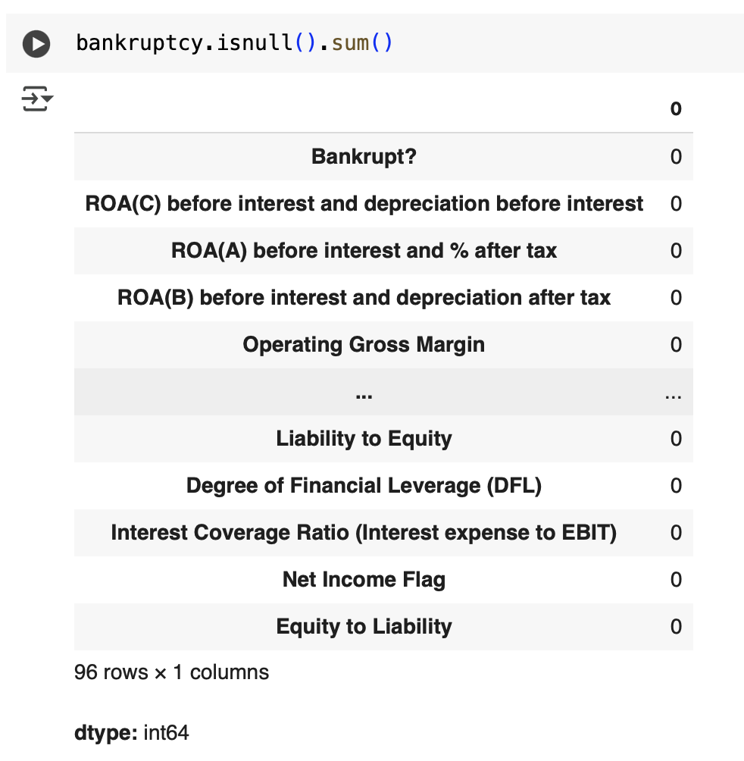


DATA PREPARATION
The dataset has been loaded using a pandas data frame
Finding null values
Data types have been previewed
Loading Data and null value analysis
Notes:
The data has been prepared in this task by loading the training and testing data into the program and analyzing the basic details of the dataset. In the basic analysis of the dataset, the missing values and outliers have been analysed. Null values have been seen in most columns of the dataset; further, the fillna method has been used for filling the missing cells in the dataset. The data types and structure have also been analysed to identify the categorical and numerical columns in the dataset. The dataset has been combined further for uniform processing of the dataset. The cabin data has been broken down into different columns, such as Deck, CabinNum, and Side.

Slide 5
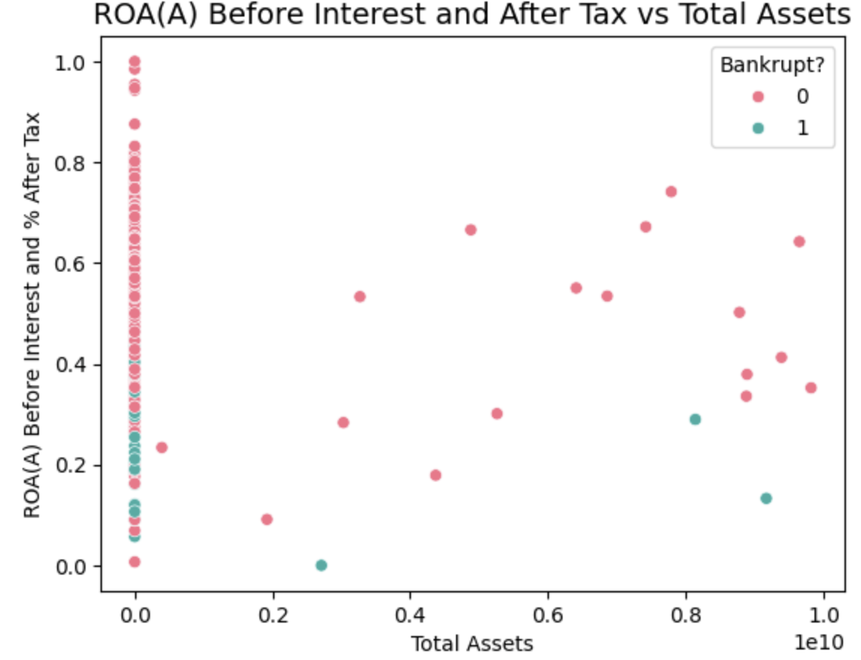
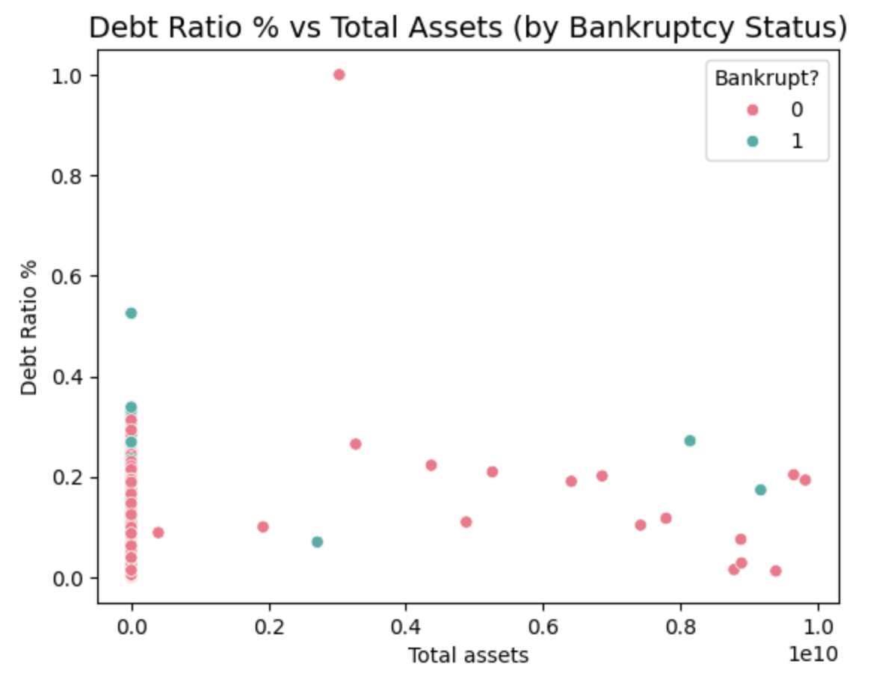
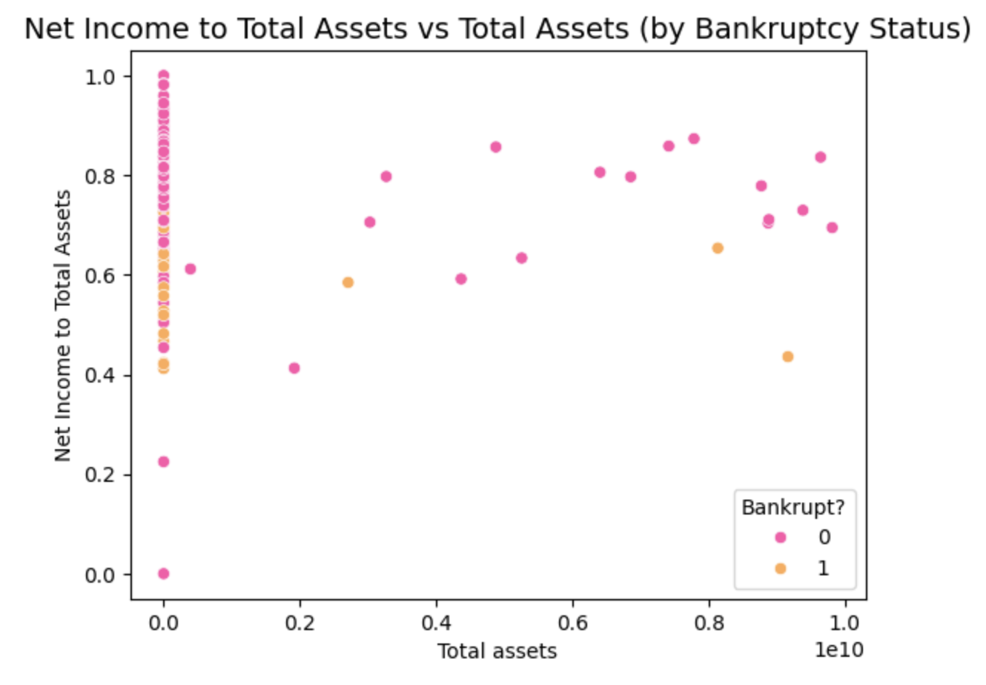
EXPLORATORY DATA ANALYSIS
Scatter plot of ROA(A) before interest and % after tax vs. Total assets
Most data points are clustered near lower total asset values, suggesting many companies in the dataset are relatively small in size.
ROA does not appear to be a strong sole indicator of bankruptcy.
Scatter plot of Debt Ratio % vs Total Assets
Most companies have low debt ratios, especially those with large total assets.
A clear indication that lower debt ratios, especially in high-asset firms, correlate with lower bankruptcy risk.
Scatter plot of Net income to total assets vs. Total assets
A similar clustering of companies with very small total assets exists here as well.
This plot suggests a slightly better separation between bankrupt and non-bankrupt companies compared to the ROA and Debt ratio plot.
Exploratory data analysis
Notes:
On this slide, there has been a presentation of in-depth exploratory data analysis to reveal insightful patterns as well as potential predictors for the target variable, Transported. From the first subplot, there is the distribution of passengers' ages, which is significantly right-skewed. There is a peak at the 20–30 age group, which shows that most passengers are young adults. There is also a visible number of children and adolescents, and fewer older passengers, indicating a relatively young population on board. In the second plot, VIP status distribution has been examined using the bar plot. The plot has represented that the vast majority of the passengers are not VIP, only a small percentage have been marked as true. Finally, the heatmap of correlation gives a quantitative understanding of the correlation between the numerical variable and the target variable (Atmanspacher and Martin, 2019). Negative correlations of spending measures, like RoomService (-0.24), Spa (-0.22), VRDeck (-0.21), and Transported, have been seen by the heatmap.

Slide 6
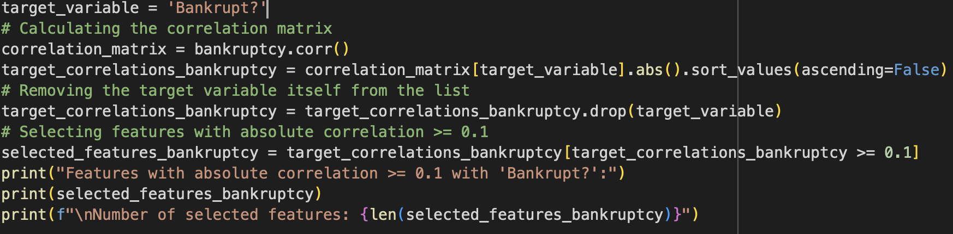
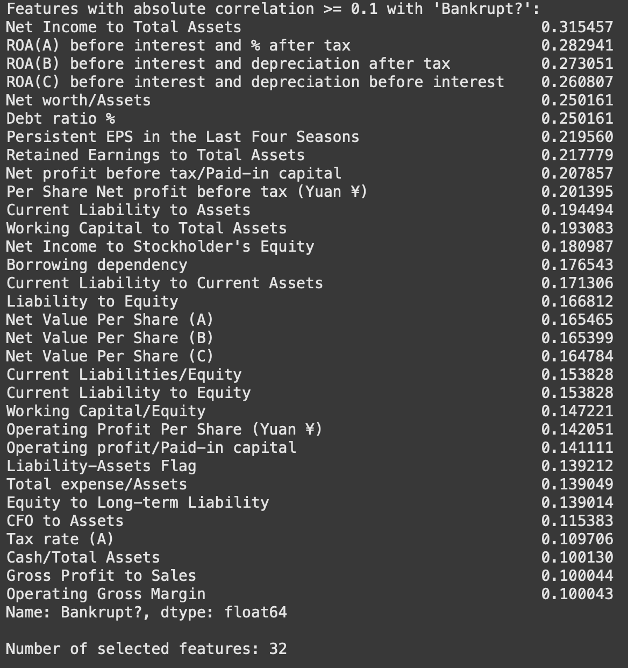
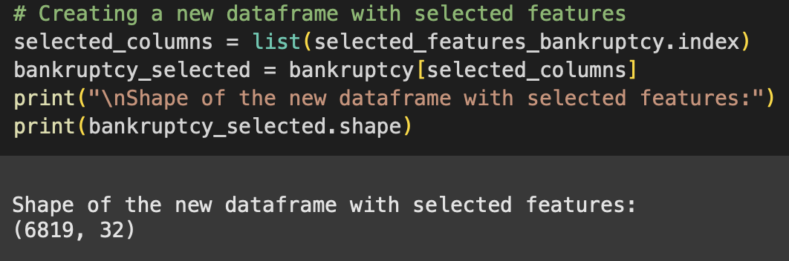
DATA PROCESSING
Measuring how strongly each feature is correlated with the target variable ('Bankrupt?’).
Finding the input features that have positive correlation
This helps reduce irrelevant or weakly related features, which can improve model performance and reduce overfitting.
Creating a new data frame with selected features.
Data preprocessing
Notes:
During the data preprocessing stage, a number of important preprocessing operations have been carried out in order to prepare the data for model training. Missing values have been treated by splitting categorical and numerical columns. Missing values for categorical features like 'HomePlanet', 'CryoSleep', and 'Destination' have been replaced with the most frequent value (mode), whereas numerical features like 'Age', 'RoomService', and 'FoodCourt' have been imputed with the median to minimize the impact of outliers. In addition, the new feature, such as 'TotalExpenses', has been generated by adding expenditures across various amenities like RoomService, FoodCourt, ShoppingMall, Spa, and VRDeck. This new feature gave a better overview of the overall spending behavior of a passenger and served as a strong predictor. After that, the categorical features have been encoded by the label encoder, which has transformed textual values into numerical form so that models can handle them efficiently (Bolikulov et al., 2024). This whole and systematic preprocessing pipeline made sure that the data was clean, relevant, and ready to be fed into machine learning models.

Slide 7
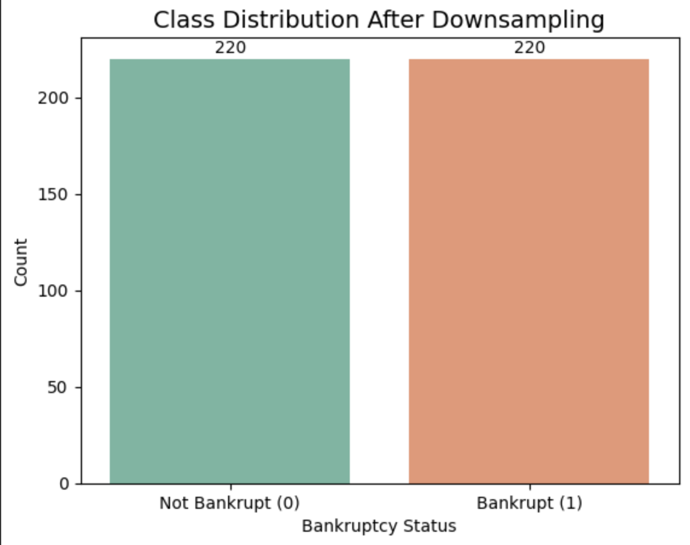
CLASS BALANCING
To address the class imbalance present in the original dataset, we applied Random Under-Sampling using the Random Under Sampler method from the imblearn library.
This technique balances the dataset by randomly removing samples from the majority class, ensuring both classes have an equal number of observations.
To verify the effectiveness of the down sampling, we generated a count plot using Seaborn to visualize the distribution of the target variable 'Bankrupt?' after resampling.
The resulting bar chart clearly shows that the number of bankrupt and non-bankrupt companies is now equal, confirming that the dataset has been successfully balanced.

Slide 8
DATA SPLIT & MODEL TRAINING
To prepare the balanced dataset for model training and evaluation, I performed a train-test split using the train, test and split function.
75% for training the machine learning model.
25% for testing the model's performance
To predict the bankruptcy status of companies, three different machine learning classification models were implemented and evaluated:
XGBoost Classifier
Random Forest Classifier
Logistic Regression
Each model was trained on the down sampled training set (75% of the balanced data). Hyperparameters were tuned using default settings initially, with potential adjustments based on validation results.
Model performance was assessed using standard classification metrics such as
Accuracy
Precision
Recall
F1-score
ROC-AUC Score
Notes:
In this slide, our project's model training and evaluation phase has been discussed, wherein two high-performance gradient boosting algorithms, such as XGBoost and LightGBM, have been utilized. Both of the models are highly acclaimed for their performance as well as speed in the task of classification. The models have been initialized with stable random seeds to provide reproducibility. A strong effectiveness assessment has been conducted by using Stratified K-Fold Cross Validation with five folds. This method has ensured that every fold has the same class distribution as the overall dataset, something that is especially helpful in imbalanced classification problems. The outcome indicates LightGBM performed better than XGBoost, with an average accuracy of 0.8155 compared to XGBoost's 0.8049. This indicates LightGBM's slightly better generalization capacity on our dataset. These results informed our choice in choosing the better-performing model for future use at deployment or more complex analysis phases.

Slide 9
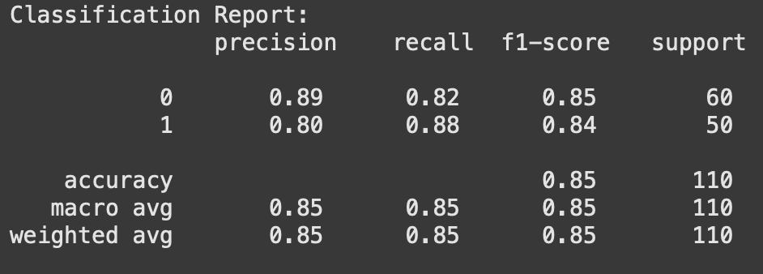
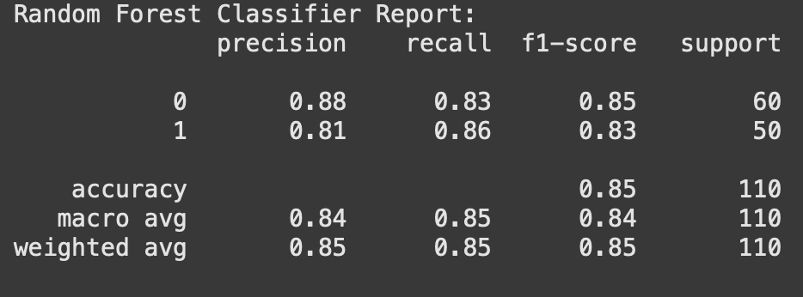
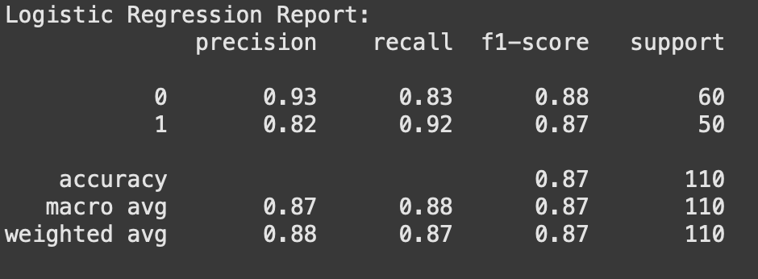
MODEL PERFORMANCE ANALYSIS
XGBoost accuracy: 0.85
Random Forest: 0.85
Logistic regression: 0.87
Notes:
Here, in this slide, we have compared and interpreted the performance of two models, which have been trained previously. Performance on different folds has been compared through cross-validation, so we can not only check the average accuracy but also the robustness of each model. As evident, the fold accuracies of XGBoost varied from 0.7964 to 0.8114 with an average accuracy of 0.8049. This minor fluctuation between folds indicates that it is doing reasonably well, but with some unpredictability in the forecast. In contrast, LightGBM performed uniformly well, with fold accuracies between 0.8124 and 0.8199, and an average accuracy of 0.8155. Not just does LightGBM have a better average accuracy, but it also shows less variability between all the folds, suggesting improved generalization on new data. This comparison brings to fore the fact that LightGBM is the more accurate and stable model in our situation, and thus the first choice for final deployment or further tuning. This is an important step in making sure our final model is both functional and stable.

Slide 10
CONCLUSION
Effective EDA and preprocessing have been performed for effective results
Logistic regression has been the best-performing model
Notes:
Systematic comparison has been made between two sophisticated gradient boosting algorithms, such as XGBoost and LightGBM, using Stratified K-Fold Cross-Validation. From the fold-wise accuracy analysis, it was found that LightGBM performed slightly better with a higher average accuracy, indicating improved generalisation.

Slide 11
REFERENCES
Asif, M., Saxena, A., Bhardwaj, S., Tiwari, S. and Chaturvedi, S. (2024) ‘A STUDY OF ALTMAN Z-SCORE BANKRUPTCY MODEL FOR ASSESSING BANKRUPTCY RISK OF NATIONAL STOCK EXCHANGE-LISTED COMPANIES’, Proceedings on Engineering Sciences, 6(2), pp. 789–806. (Available at: https://doi.org/10.24874/PES06.02A.006.)
Di Quirico, R. (2023) ‘Uncertainty, Anxiety and the Post-Pandemic Economic Environment’, Clinical Neuropsychiatry, 20(4), p. 227. (Available at: https://doi.org/10.36131/cnfioritieditore20230401.)
Statista (2025) Largest U.S. bankruptcies as of June 2019, Statista. (Available at: https://www.statista.com/statistics/1096794/largest-bankruptcies-usa-by-assets/) [Accessed: 29 May 2025].
Tierney, A. (2024) Number of business bankruptcies U.S. 2000-2020, Statista. (Available at: https://www.statista.com/statistics/817918/number-of-business-bankruptcies-in-the-united-states/) [Accessed: 29 May 2025].

Slide 12
THANK YOU

